Slide 1
University of Helsinki
Department of Computer Science
Non-uniform zooming with multi-touch technology
Md. Nazmul Haque Khan
Mohsen Koolaji
Zinat Rasooli Mavini
Feihua Qu
Yina Ye

Slide 2
Agenda
What are we going to do?
Where?
Posasible Cool Features
How are we going to do it?
Related Studies

Slide 3
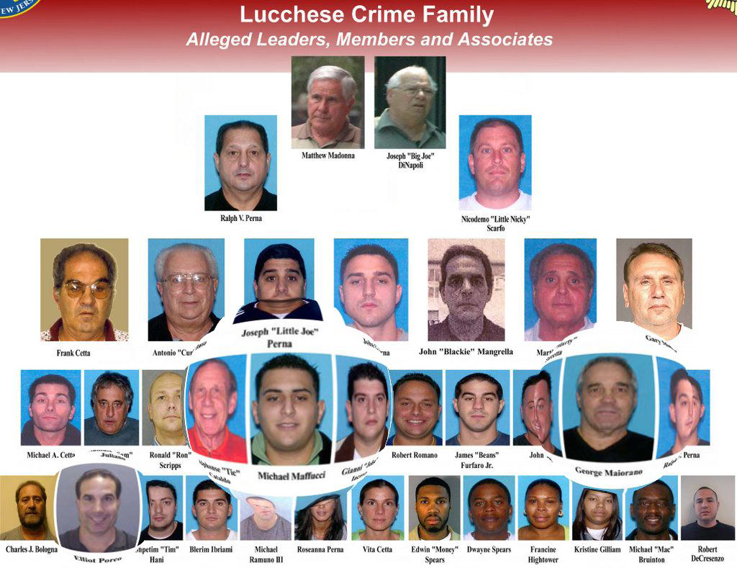
What are we going to do?
Source: http://media.nj.com/ledgerupdates_impact/photo/nj-operation-heat-lucchese-crime-familyjpg-f4b917a7dbe32d37_large.jpg

Slide 4
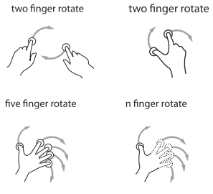
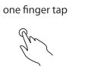
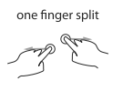
Features
Zooming
Interactive Interface and Design
Gestures
Source: http://gestureworks.com/

Slide 5
How are we going to do it…
OpenGL's 3D function and APIs
fisheye view algorithms
multi touch capability & methodologies
information visualization
gesture recognition
multi touch gestures
multi touch programming

Slide 6
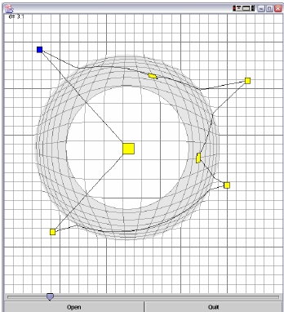
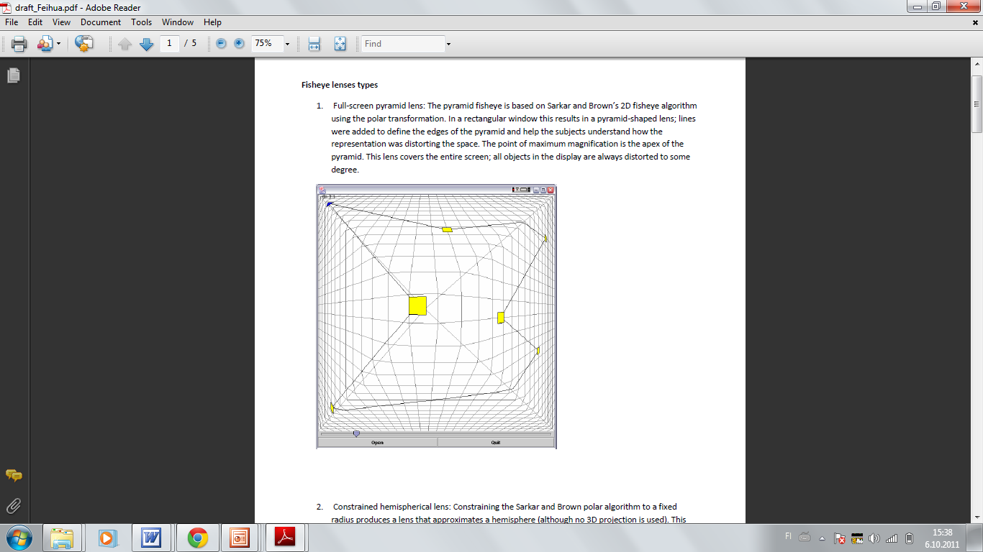
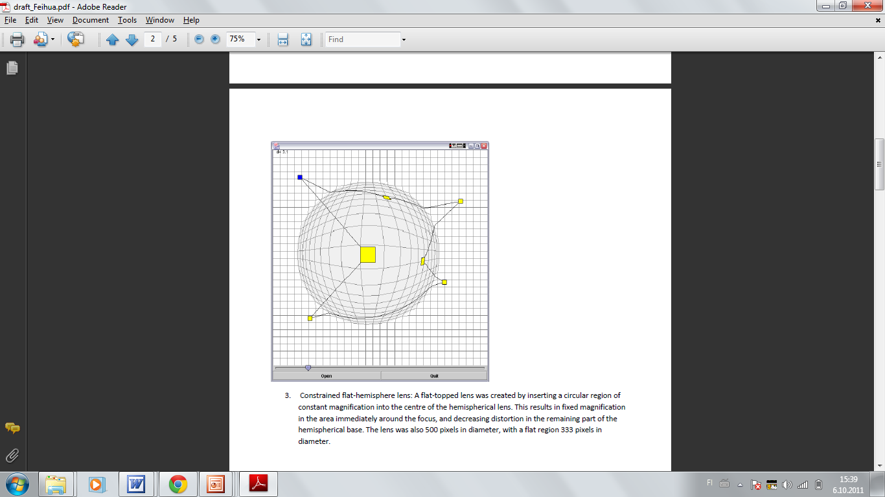
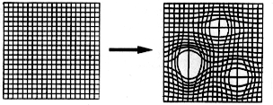
Related Studies
Source. http://www.ee.ic.ac.uk/research/information/www/Bobs.html

Slide 7
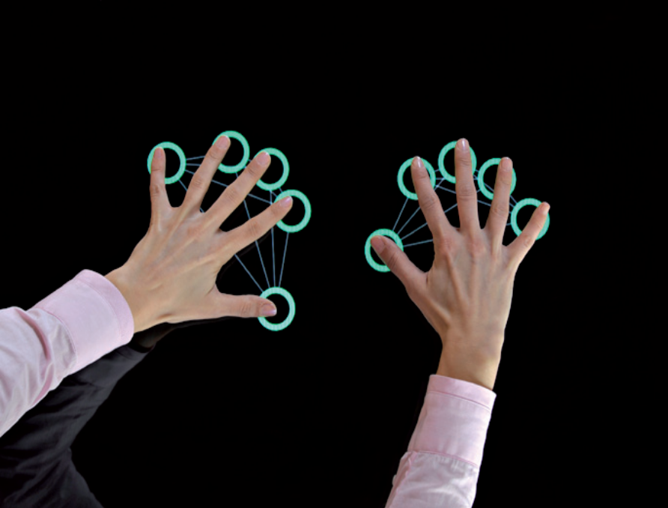
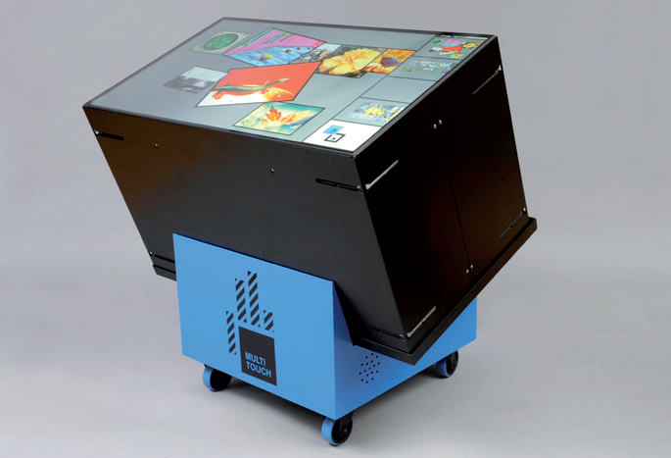
Where?
46” LCD. Depth 299 mm/11.77”, weight 37 kg/82 lbs
Full HD, 1920-by-1080p-pixel resolution (2,1 MP)
Limitless combinations for large-scale arrays
Stackable, movable and VESA mounting
Inclinable to any position
Low maintenance, scratch-resistant front glass
Source. http://multitouch.fi/products/

Slide 8
Thanks

Slide 9
Comments/Suggestions…

